Slide 1
LUNG CANCER CLASSIFICATION
Machine Learning Project
1

Slide 2
ABOUT THE PROJECT
Lung cancer classification using the Lung Cancer Prediction dataset
Machine learning project
Supervised by :
Prof. Ehab Essa
Eng. Abdelrahman Gamal
2

Slide 3
Table Of Content
1
2
3
4
5
6
3

Slide 4
Introduction
4

Slide 5
INTRODUCTION
This dataset contains information on patients with lung cancer, including their age, gender, air pollution exposure, alcohol use, dust allergy, occupational hazards, genetic risk, chronic lung disease, balanced diet, obesity, smoking status, passive smoker status, chest pain, coughing of blood, fatigue levels, weight loss, shortness of breath, wheezing, swallowing difficulty, clubbing of fingernails, frequent colds, dry coughs, and snoring. By analyzing this data, we can gain insight into what causes lung cancer and how best to treat it
Dataset dimensions --> 1000 record x 26 column
5

Slide 6
Motivation
6

Slide 7
Motivation
What if I told you that the dataset help us predicting if any person have lungs cancer or not , How to build a model to help us predicting if we have the disease earlier ? , What common ways we can do to decrease the probability of getting it ?
How can we solve such problem like this but first we need to have a look at the dataset and explore it .
7

Slide 8
Columns Explaining
Age: The age of the patient. (Numeric) "-
Gender: The gender of the patient. (Categorical)
Air Pollution: The level of air pollution exposure of the patient. (Categorical)
Alcohol use: The level of alcohol use of the patient. (Categorical)
Dust Allergy: The level of dust allergy of the patient. (Categorical)
Occupational Hazards: The level of occupational hazards of the patient. (Categorical)
Genetic Risk: The level of genetic risk of the patient. (Categorical)
Chronic Lung Disease: The level of chronic lung disease of the patient. (Categorical)
Balanced Diet: The level of a balanced diet of the patient. (Categorical)
Obesity: The level of obesity of the patient. (Categorical)
8

Slide 9
Columns Explaining
Smoking: The level of smoking of the patient. (Categorical)
Passive Smoker: The level of passive smoker of the patient. (Categorical)
Chest Pain: The level of chest pain of the patient. (Categorical)
Coughing of Blood: The level of coughing of the blood of the patient. (Categorical)
Fatigue: The level of fatigue of the patient. (Categorical)
Level : Intensity of the cancer(Low, Medium or High)
Weight Loss: The level of weight loss of the patient. (Categorical)
Shortness of Breath: The level of shortness of breath of the patient. (Categorical)
Wheezing: The level of wheezing of the patient. (Categorical)
Swallowing Difficulty: The level of swallowing difficulty of the patient. (Categorical)
Clubbing of Fingernails: The level of clubbing of the fingernails of the patient. (Categorical)
Our Job is to Predict the Level Column Value
9

Slide 10
Data Preprocessing & Visualization
10

Slide 11
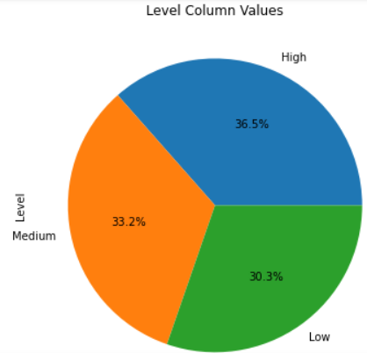
Data Preprocessing & Visualization
Most People in Dataset are having High Risk of getting Cancer with 36.5% , 33.2% are Having Medium Risk & about 30% Low
11

Slide 12
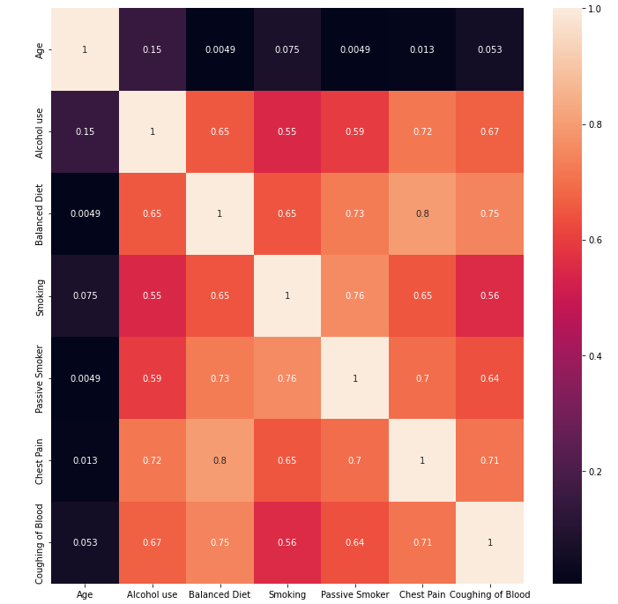
Data Preprocessing & Visualization
Small Version Of Heat Map to see the Correlation between The Columns.
It also shows us that obesity, air pollution, balanced diet, cough of blood, passive smoker is strong correlated with lung caner, therefore we should be alert when these factors occur to us.
12

Slide 13
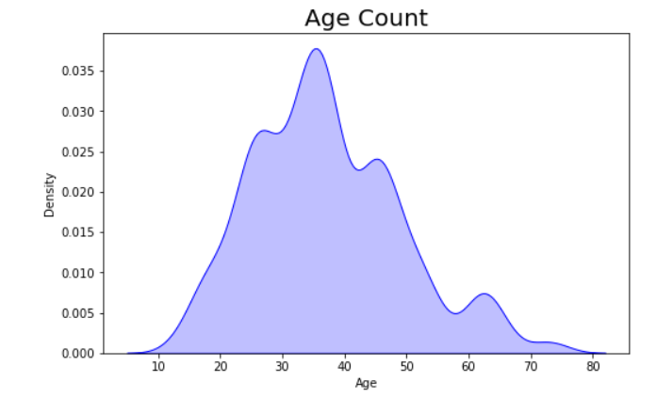
Data Preprocessing & Visualization
Most People in Dataset Age are from 30 to 40 years old.
13

Slide 14
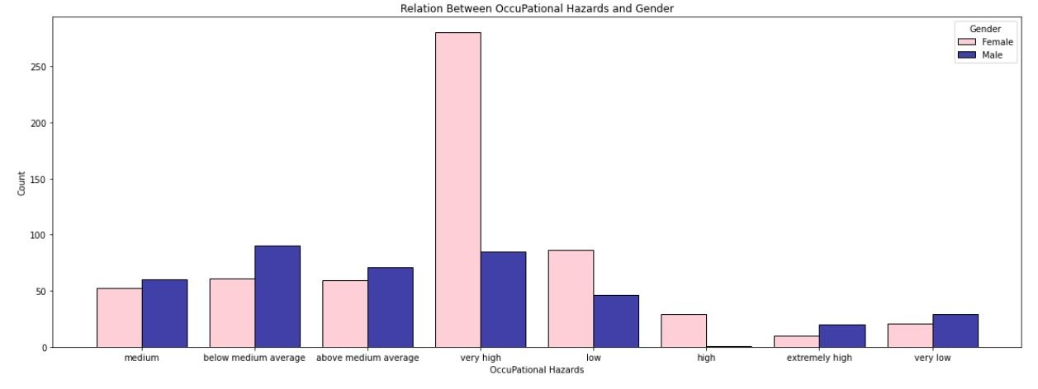
Who are more susceptible to disease ?
Data Preprocessing & Visualization
females are more likely to get lungs disease with high ratios compared to men
14

Slide 15
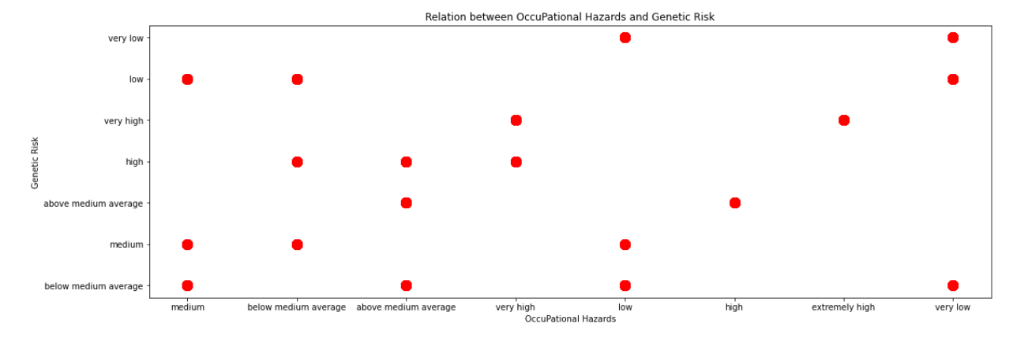
How are Occupational Hazards affected by Genetic Risk?
Data Preprocessing & Visualization
There's a postive correlation between them as people with high genetic risk are having high occupational hazards.
15

Slide 16
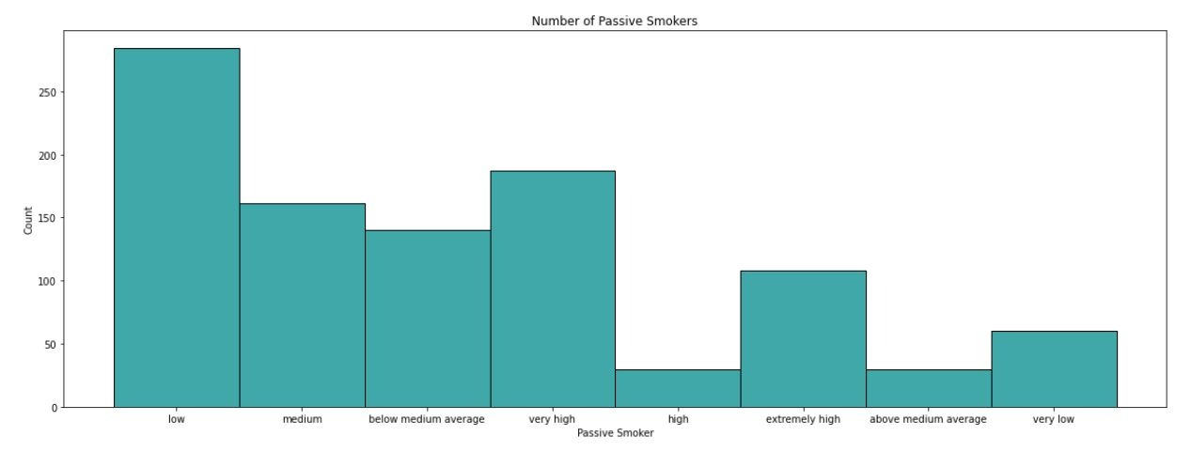
How Many Smokers we have and how much they smoke ?
Data Preprocessing & Visualization
Most Passive Smokers are Smoking in low values nearly about 300 Smoker
16

Slide 17
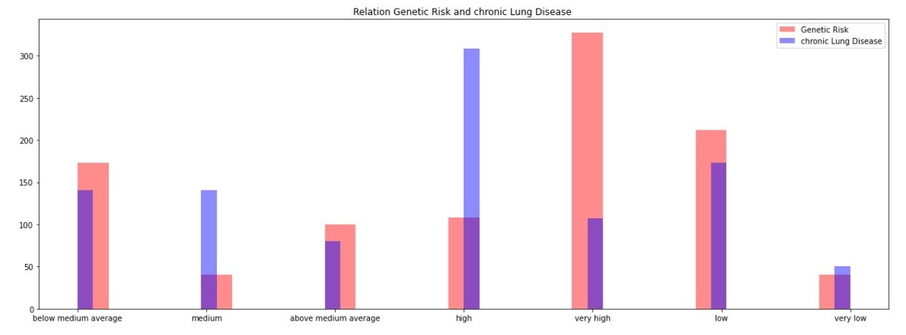
What is the Relation between Genetic Risk and chronic Lung Disease ?
Data Preprocessing & Visualization
Seems like Genetic Risk has no effect on chronic Lung Disease
17

Slide 18
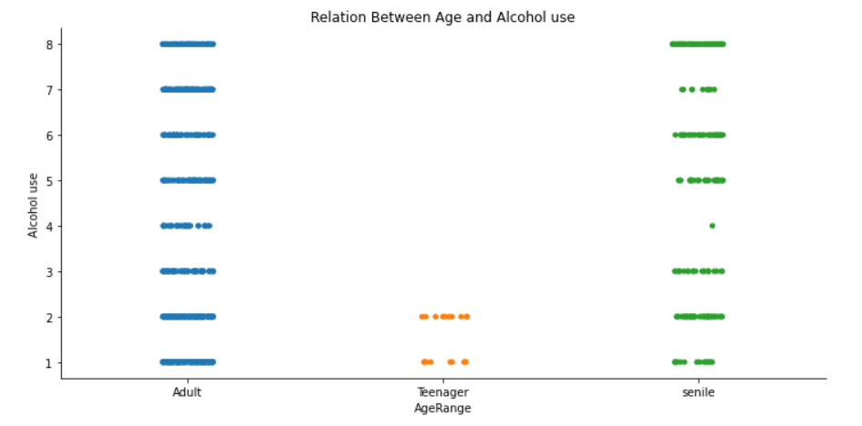
Who is drinking the most alcohols ?
Data Preprocessing & Visualization
Adults are the most people to drink alcohols ( 18 < Adults < 45 )
18

Slide 19
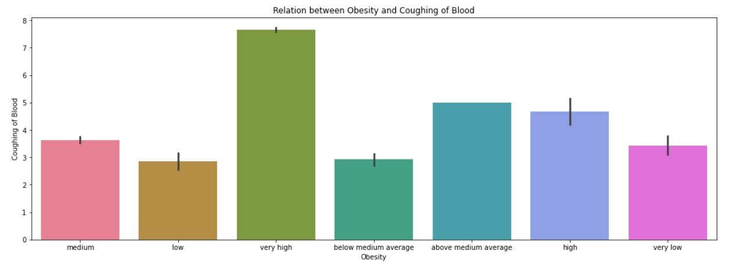
How is Obesity affecting Coughing of blood level ?
Data Preprocessing & Visualization
As Expected people with high obesity tends to have more coughing of blood ?
19

Slide 20
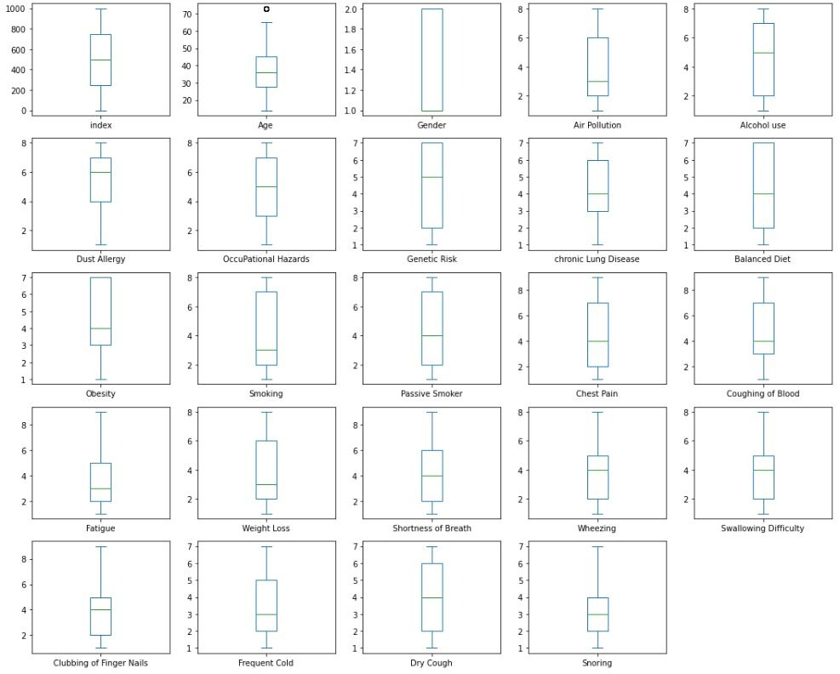
Are there is any outliers in the dataset ?
Data Preprocessing & Visualization
No Outliers found in the data .
20

Slide 21
Modeling & Evaluation
21

Slide 22
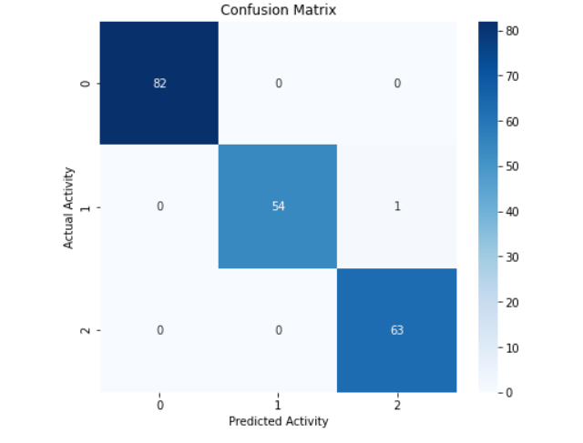
We first used Standard Scaler then we started modelling by different models.
Modeling & Evaluation
Logistic Regression
Accuracy Score : 99.75 %
Precision Score : 99.5 %
Recall Score : 99.7 %
F_Score : 99.6 %
22

Slide 23
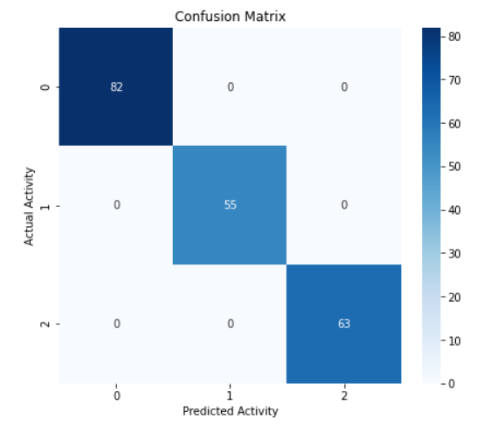
We first used Standard Scaler then we started modelling by different models.
Modeling & Evaluation
KNN
At K = 5
Accuracy Score : 99.8 %
Precision Score : 99.5 %
Recall Score : 99.6 %
F_Score : 99.5 %
23

Slide 24
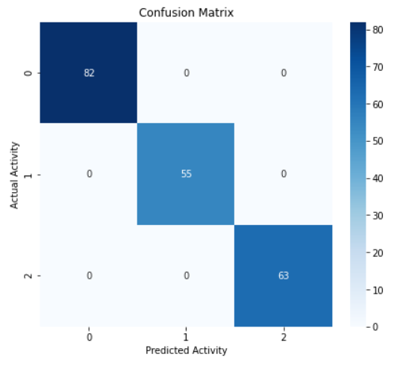
We first used Standard Scaler then we started modelling by different models.
Modeling & Evaluation
LSVM
Accuracy Score : 99.7 %
Precision Score : 99.6 %
Recall Score : 99.8 %
F_Score : 99.7 %
24

Slide 25
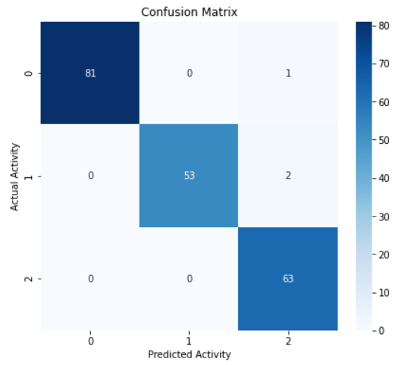
We first used Standard Scaler then we started modelling by different models.
Modeling & Evaluation
SVM
Kernel = Radial Basis Function
Accuracy Score : 99.8 %
Precision Score : 99.5 %
Recall Score : 99.6 %
F_Score : 99.5 %
25

Slide 26
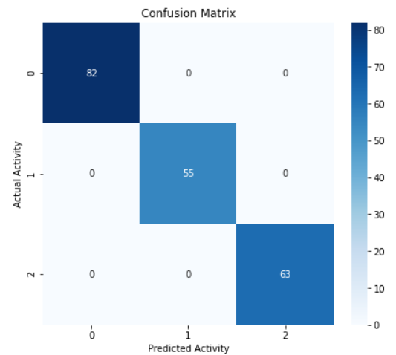
We first used Standard Scaler then we started modelling by different models.
Modeling & Evaluation
Random Forest Classifier
Accuracy Score : 100%
Precision Score : 100%
Recall Score : 100%
F_Score : 100%
26

Slide 27
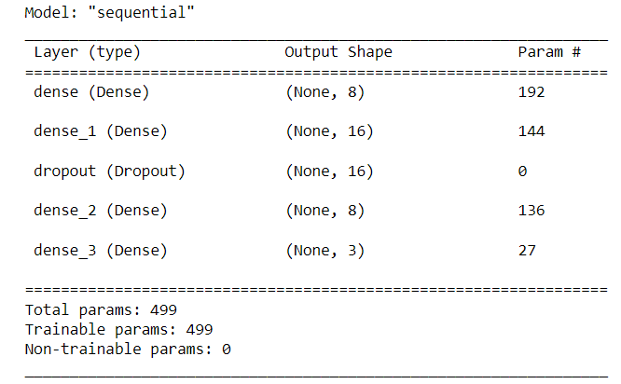
Neural Network Model Summary
Modeling & Evaluation
27

Slide 28
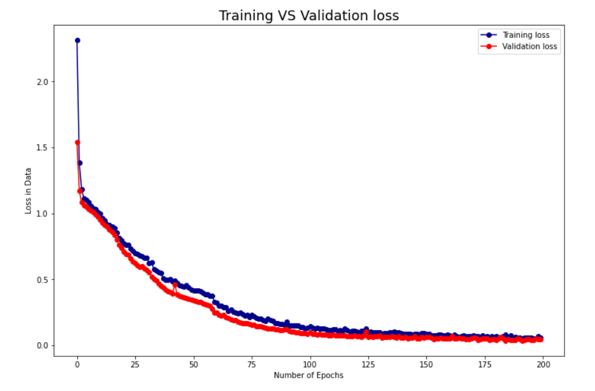
Checking Loss data in the Model
Modeling & Evaluation
28

Slide 29
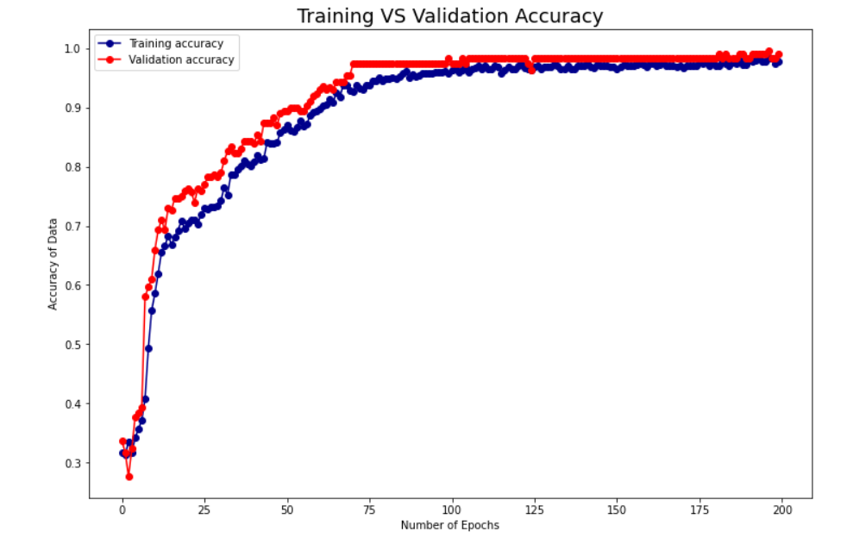
Checking the Accuracy of data in the Model
Modeling & Evaluation
29

Slide 30
Summary
Model | Accuracy | Best model
Logistic | 99.75%
KNN | 99.8%
LSVM | 99.7%
RBF SVM Random Forest | 99.8% 100%
30

Slide 31
Conclusion
31

Slide 32
Data Summary
Conclusion
There are no outliers or duplicates in the Dataset.
No Outliers Found in the dataset.
Dataset Didn’t Need Much Preprocessing.
Many Classification Models can be applied for this dataset and all give high Accuracy.
Random Forest Classifier Performed the Best Accuracy with 100%.
32

Slide 33
General Solutions To The Problem
Types of Treatment
Lung cancer is treated in several ways, depending on the type of lung cancer and how far it has spread. People with non-small cell lung cancer can be treated with surgery, chemotherapy, radiation therapy, targeted therapy, or a combination of these treatments. People with small cell lung cancer are usually treated with radiation therapy and chemotherapy.
Surgery. An operation where doctors cut out cancer tissue.
Chemotherapy. Using special medicines to shrink or kill the cancer. The drugs can be pills you take
or medicines given in your veins, or sometimes both.
Radiation therapy. Using high-energy rays (similar to X-rays) to kill the cancer.
Targeted therapy. Using drugs to block the growth and spread of cancer cells. The drugs can be
pills you take or medicines given in your veins. You will get tests to see if
targeted therapy is right for your cancer type before this treatment is used.
33

Slide 34
Deployment
34

Slide 35
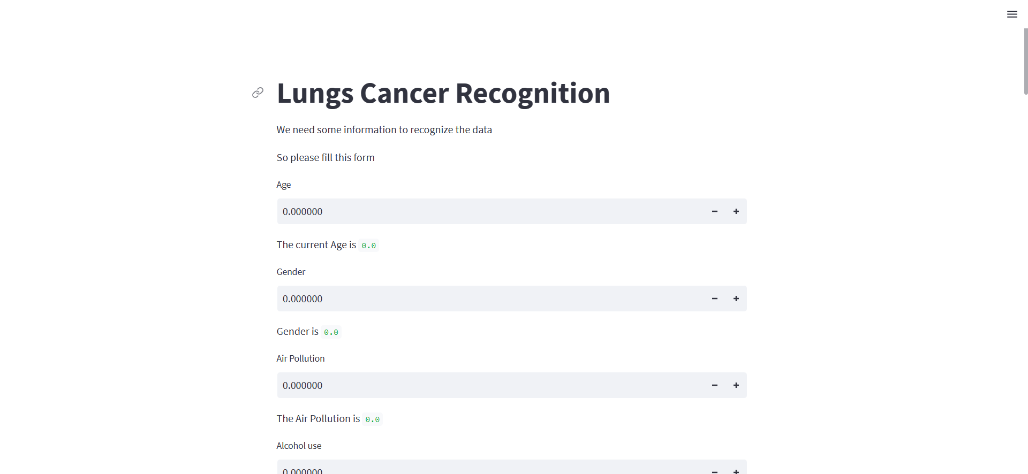
Deployment
Check our website made by Streamlit for Lungs Cancer Classification.
35

Slide 36
Team members
Yousef Abdel Mottaleb
Mohamed Abd El-Aziz
Nourhan Mahmoud
Ranim Ahmed
Ahmed Elsharkawy
36

Slide 37
Thank You
If you have any questions , Please don’t hesitate we would love to hear your honest opinion.
37

